Slide 1
R Clinic
Session 13: Introduction to Phylogenetics

Slide 2
Overview
View and explore phylogenetic trees
Controlling for phylogeny in regressions
Phylogenetic autocorrelation introduced by shared ancestry and body mass
Healy et al. (2014) Ecology and mode-of-life explain lifespan variation in birds and mammals

Slide 3
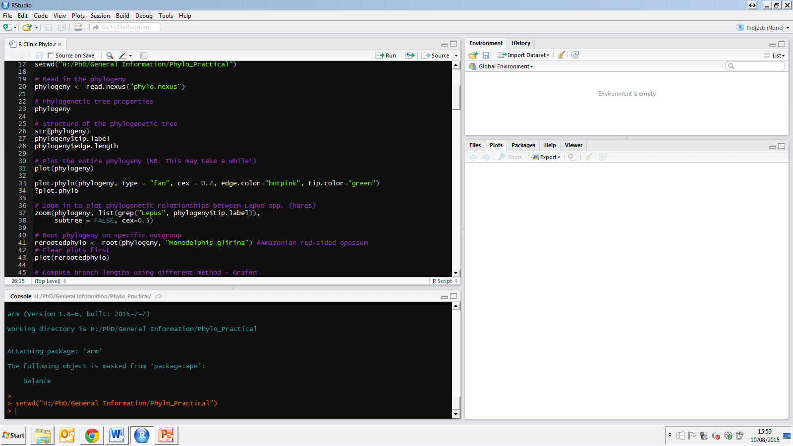
Reading in phylogenies
Many phylogenies available online
Mammal phylogeny
For Nexus files
For Newick files (.tre)
read.tree()

Slide 4
Phylogenetic tree properties

Slide 5
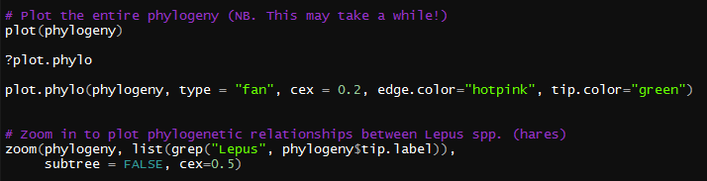

Plotting phylogenetic trees
Can use (plot) but plot.phylo() provides more options for changing parameters

Slide 6
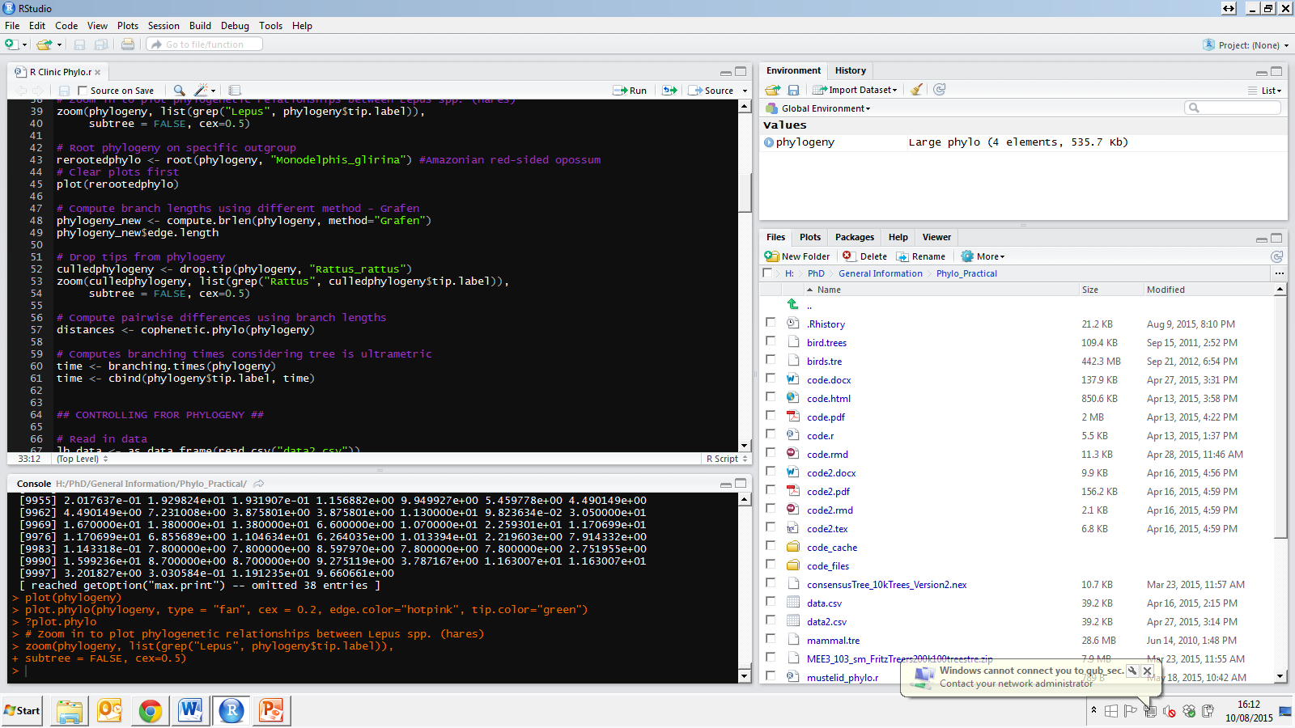
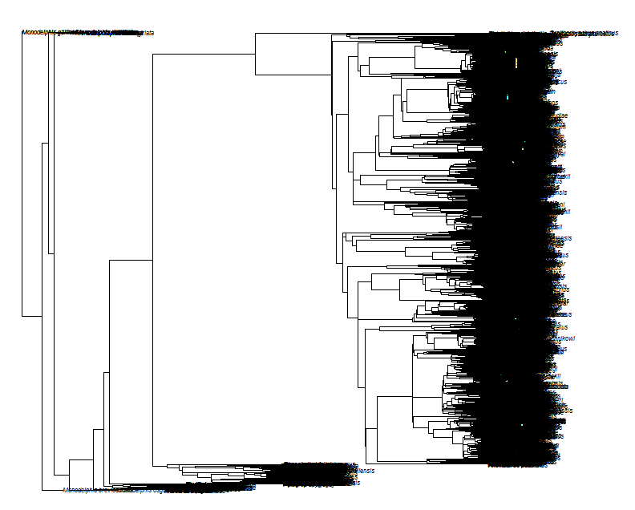
Change root of phylogeny

Slide 7
Compute branch lengths
“Grafen's (1989) computation of branch lengths: each node is given a ‘height’, namely the number of leaves of the subtree minus one, 0 for leaves.
Each height is scaled so that root height is 1, and then raised at power 'rho' (> 0).
Branch lengths are then computed as the difference between height of lower node and height of upper node.”

Slide 8
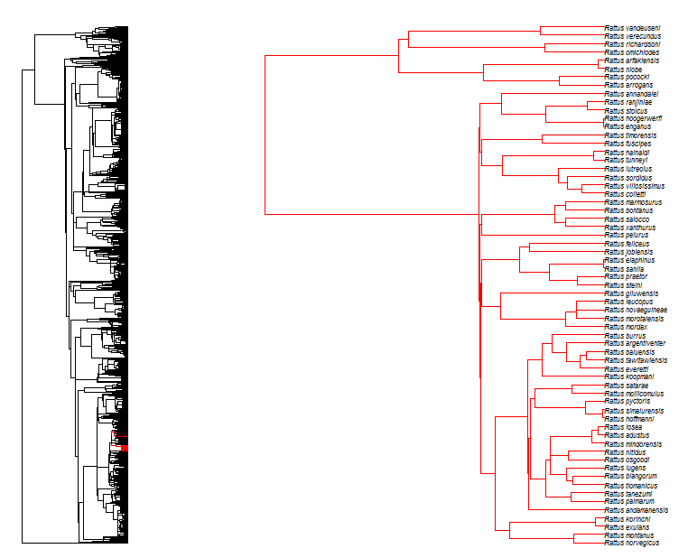
Drop species from phylogenies

Slide 9
Phylogenetic distances
Branching times

Slide 10
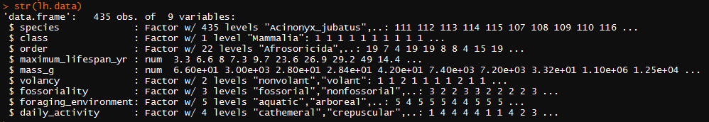
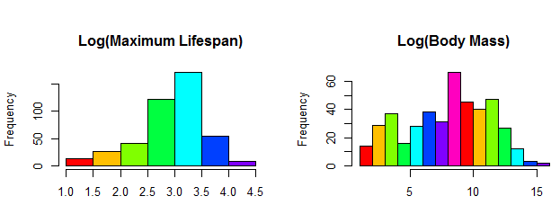
Life history data for regressions
Mammalian data from Healy et al. 2014

Slide 11
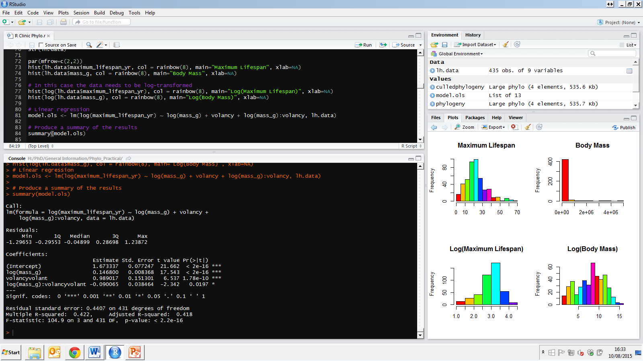
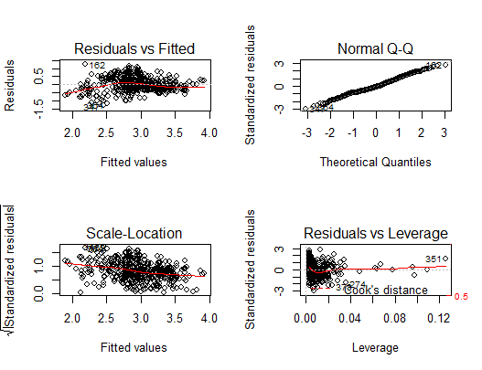
Linear regression

Slide 12
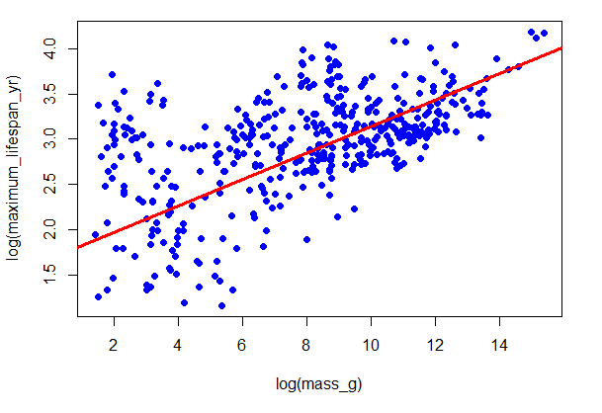
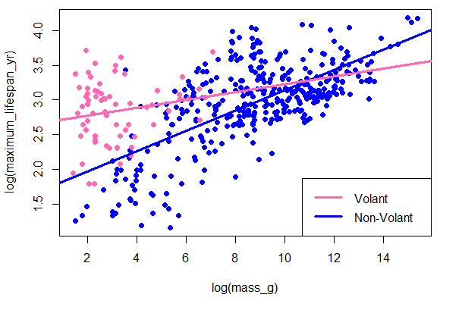
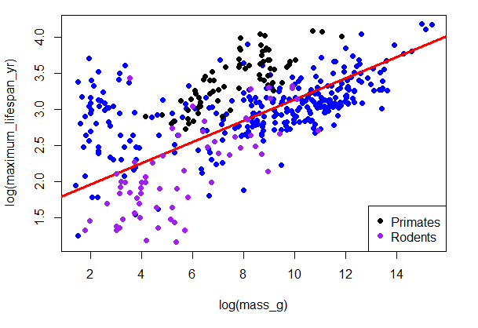
Explore relationships

Slide 13
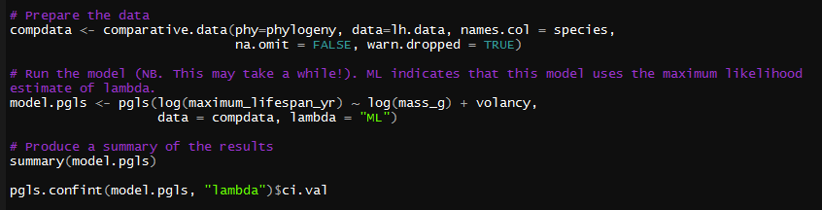
Control for phylogeny
Accounts for shared evolutionary history between species that might affect their lifespan independent of body size or other variables
Lambda captures the strength of shared evolutionary history in your model
Zero = no phylogenetic signal (i.e. pattern of lifespan not to do with evolutionary history)
One = ALL variation in mammalian lifespan is explained by shared common ancestry

Slide 14
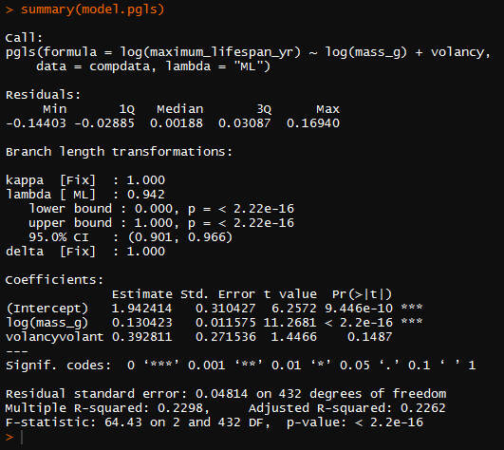
Control for phylogeny

Slide 15
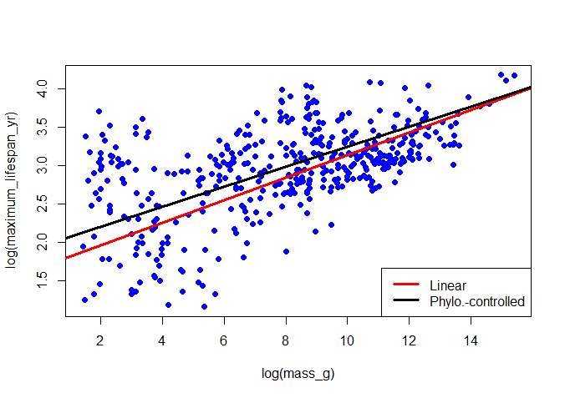
Control for phylogeny

Slide 16
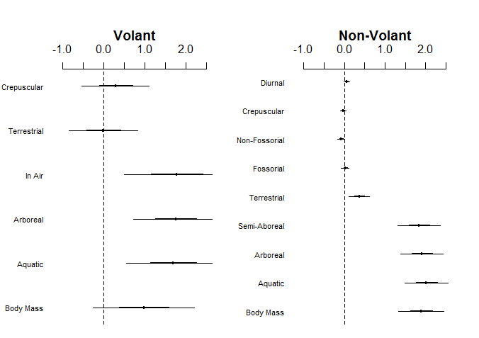
Full models
Healy et al. (2014) then incorporate additional factors to account for foraging environment, fossoriality (burrowing) and activity period

Slide 17
Further information
Exploring trees:
http://www.r-phylo.org
https://www.zoology.ubc.ca/~schluter/R/phylogenetic/
Alternative way to control for phylogeny:
http://luisdva.github.io/Ordinal-models/
Bayesian phylogenetic mixed models (BPMMs)

Slide 18
Summary
Main R packages for phylogenetic analysis include “caper” and “ape”
Plot.phylo() is really useful for plotting phylogenies!
In multi-species analysis, even simple regressions, phylogeny needs to be considered given the large effects it has on the relationships shown here.

Slide 19
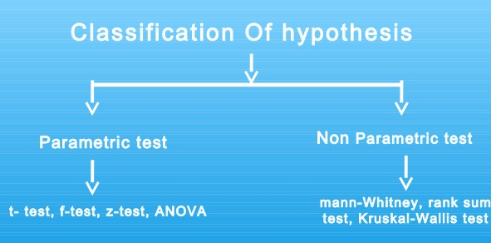
Next week
Non-parametric tests
Room G122 MBC - bring your own laptop

